Slide 1
Online Data Sources
Lab 2

Slide 2
Agenda
easy
Publicly available tabular datasets
Data from research papers, repositories
Getting data with API’s
Data within web pages
R Markdown basics
Downloading and parsing web pages with R
Dealing with unstructured data: regular expressions
hard

Slide 3
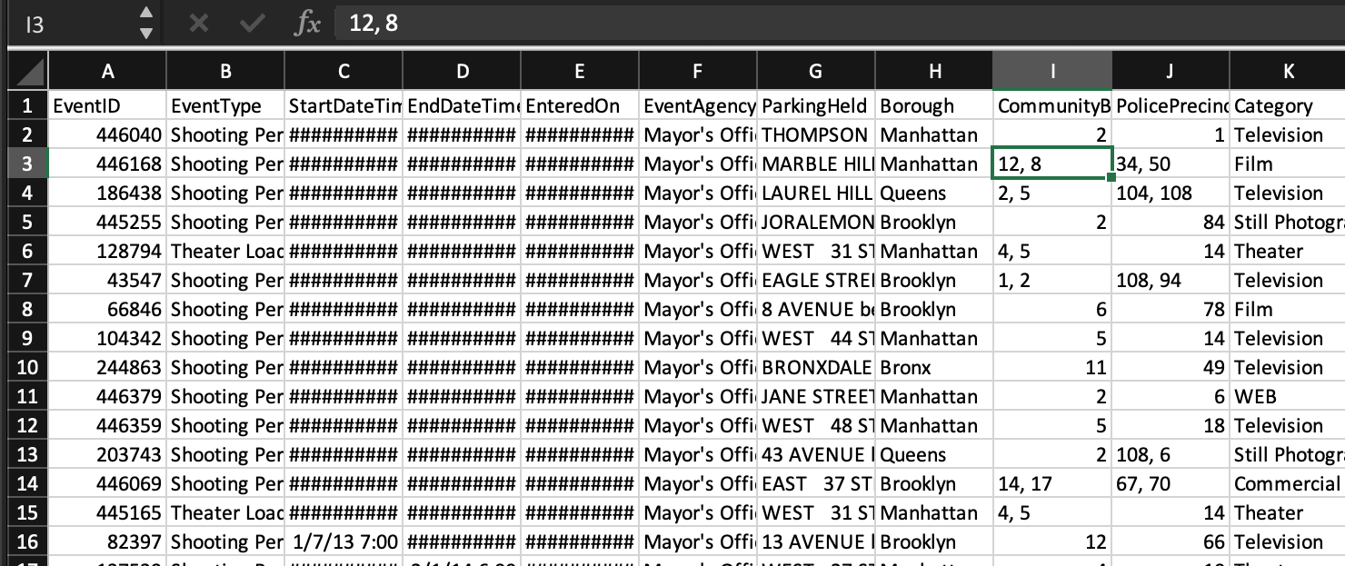
Publicly available tabular data
50 Amazing Free Data Sources You Should Know
Data.gov
NYC OpenData
Google Dataset Search
US Census Table viewer

Slide 4
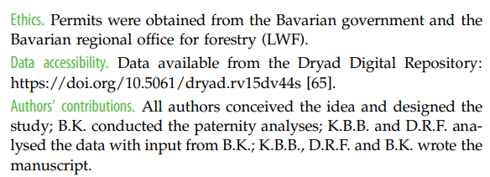
Data from research papers
Nature repository guidelines
Example: Harvard Dataverse

Slide 5
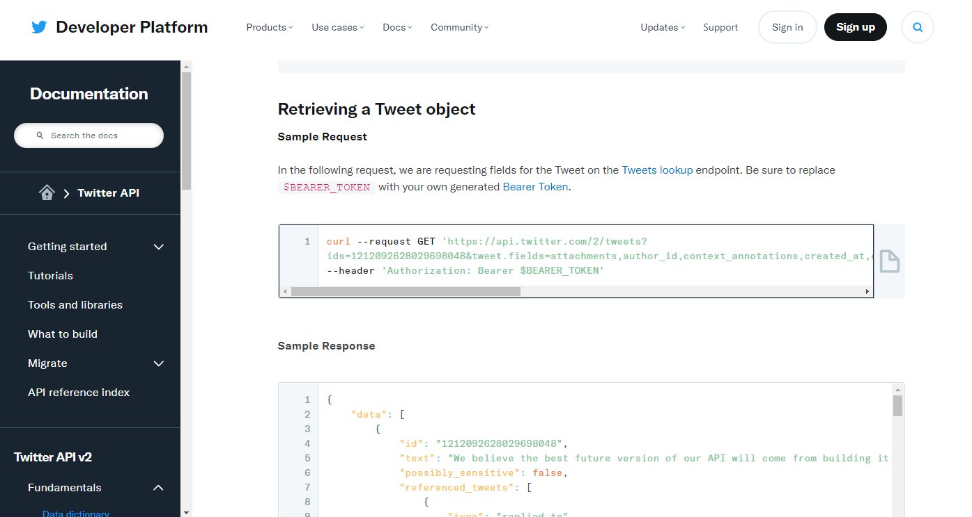
Getting data with API’s
Application Programming Interface

Slide 6

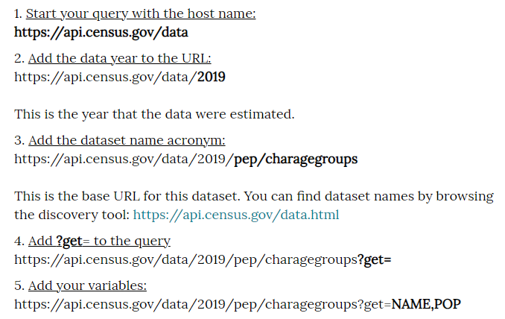
Getting data with API’s

Slide 7
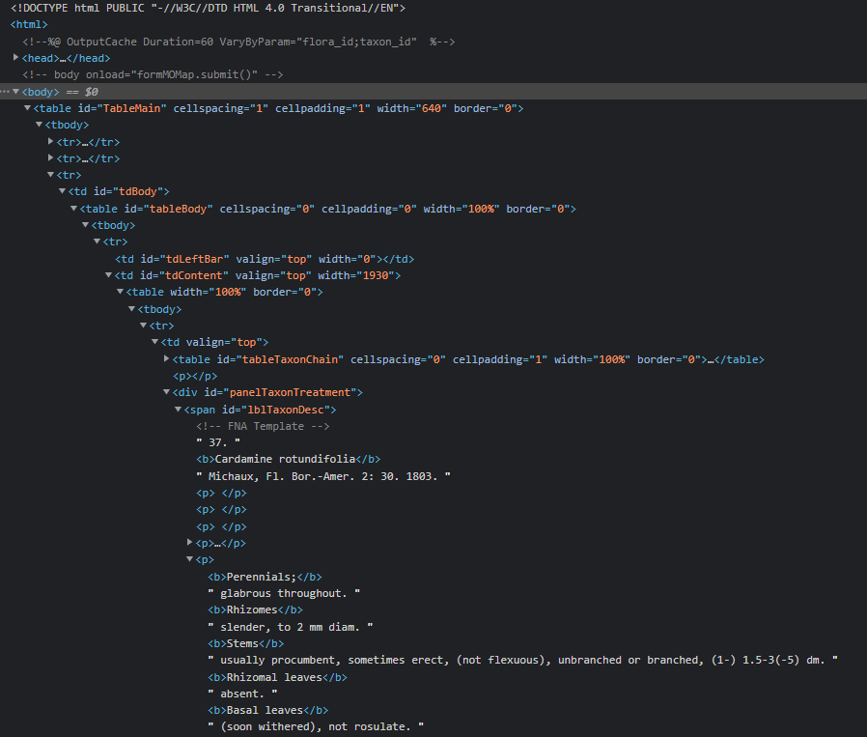
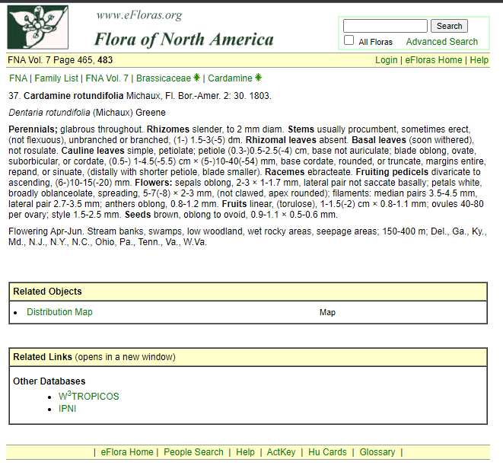
Data within web pages

Slide 8
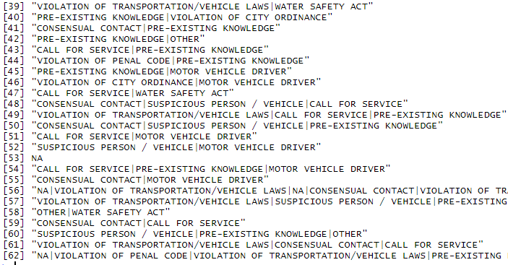
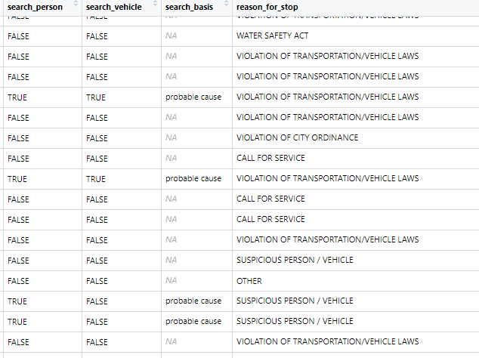
Managing text with regular expressions

Slide 9
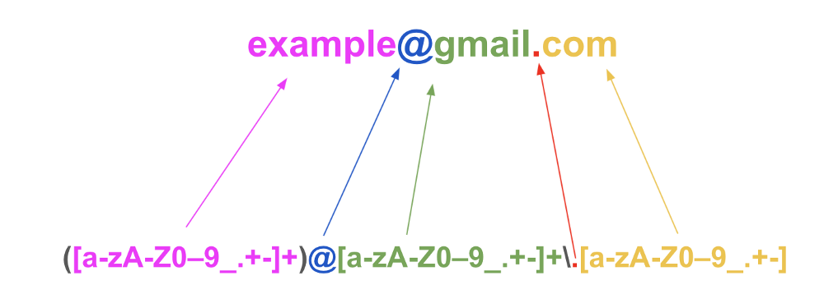
Managing text with regular expressions
More about learning regular expressions (regex)
Regex cheat sheet

Slide 10

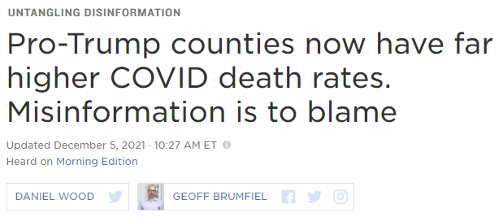
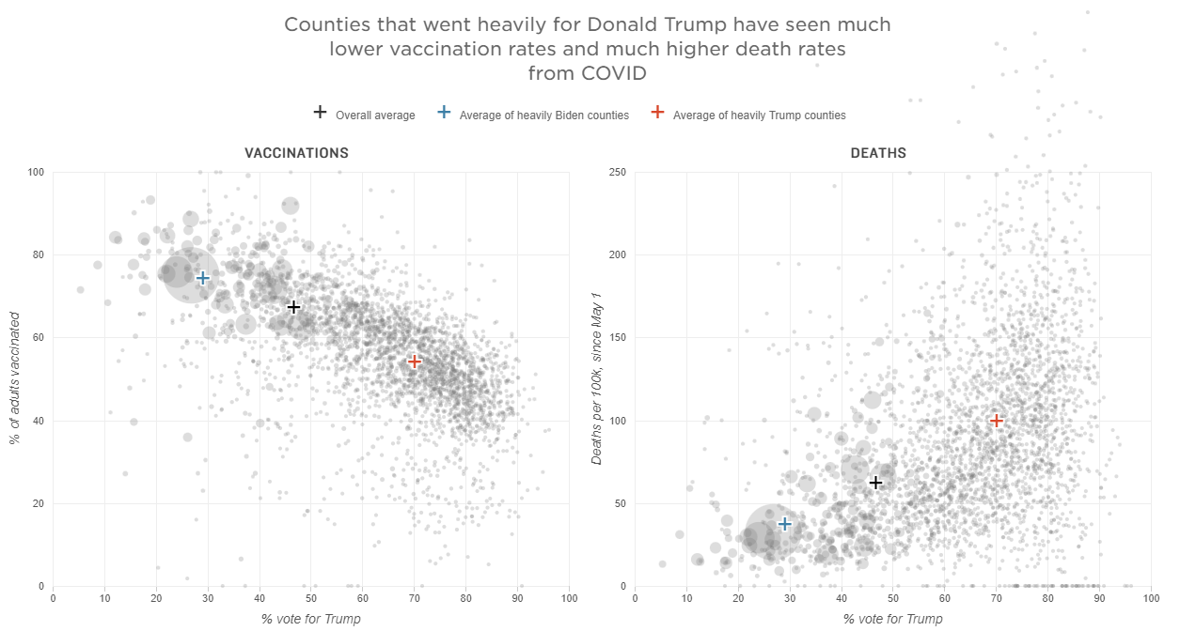

Slide 11
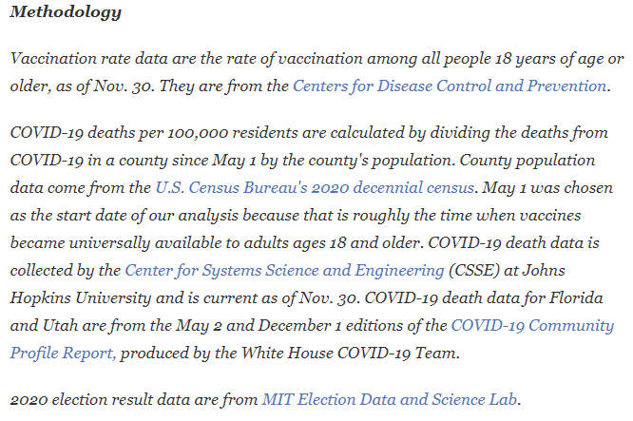
Integrating data from multiple sources

Slide 12
Integrating data from multiple sources
Adding variables (columns)
needs same # rows, and a linking variable
Adding observations (rows) needs same # columns
A
B
C
C
D
E
A
B
C
1
1
2
2
3
3
4
5
4
6
5
6

Slide 13
Integrating data from multiple sources
What do we do here?
A
B
C
A
B
C
D
E
1
1
C
D
E
 |  |  | NA | NA
 |  |  | NA | NA
 |  |  | NA | NA
2
2
1
3
3
2
4
4
3
5
5
6
6

